Slide 1
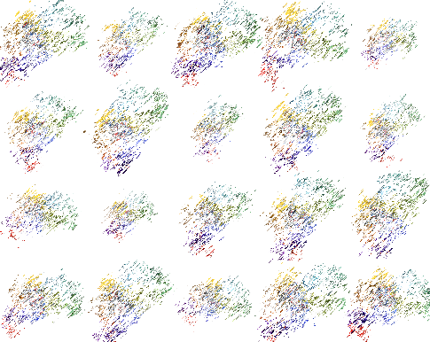
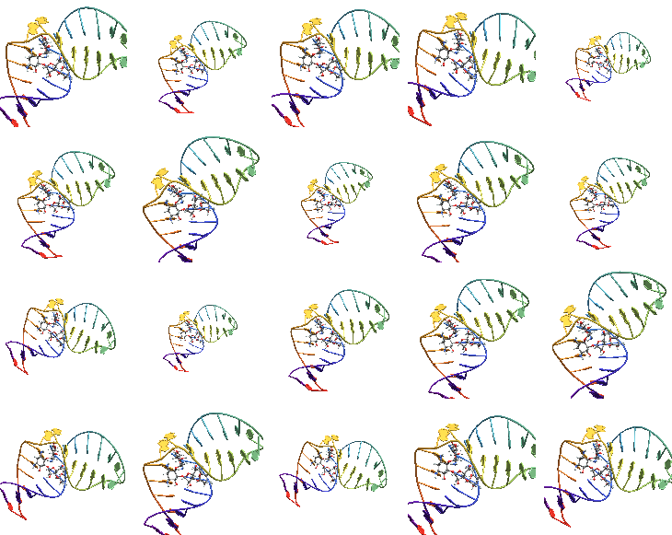
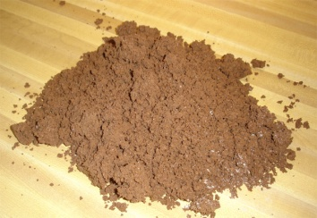
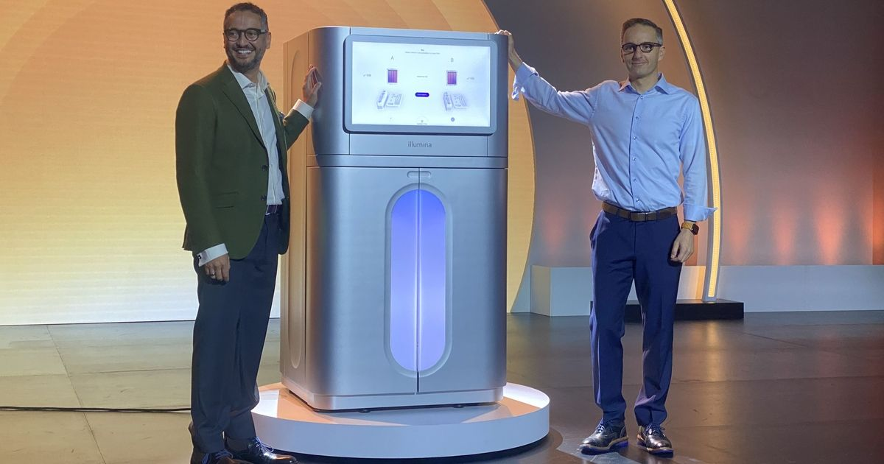
Metagenomics
What’s the data?
Whole Genome Shotgun (WGS) metagenomics
Environmental sample
10’s to 1000’s of Gigabytes
>Seq_1
AAAATCTTGACTGACTCTGACTACGATGCATGCTACGG….
>Seq_2
GGGCTGACTTGCACTGTCTTGATATACTACGATGACTG…
>Seq_3
GCTGATGACTGACTGTGGGGGGGTGAGTTCTGCAGA…
>Seq_4
GTGCTACTACTCTACTACTACTTTTAATTACTATATACCC…

Slide 2
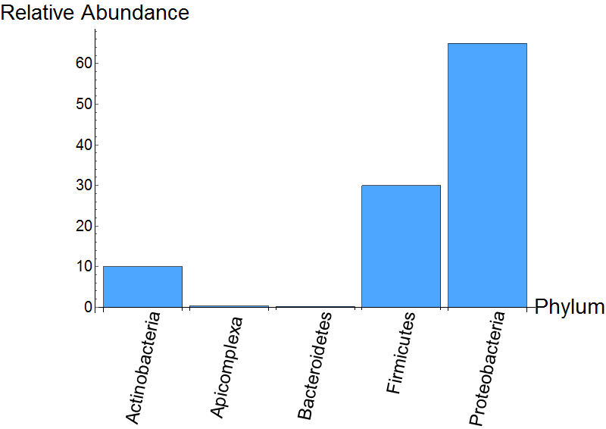

Metagenomics
Computational techniques
Comparison
Taxonomic profiling
Reads
Functional annotation/profiling
Assembly
Gene Family 1
Gene Family 2
Contigs
Gene Family 3
Genome binning
Taxonomic binning
Bin 1
Actinobacteria
Bin 2
Escherichia coli K-12
Unassigned
Unassigned

Slide 3




Genomics and metagenomics research can be computationally overwhelming
Metagenomics
Metagenome
Sampling
Whole Shotgun Sequencing
400k genomes
80k species
3TB genetic data
More accessible sequencing
Leading to time consuming analyses

Slide 4

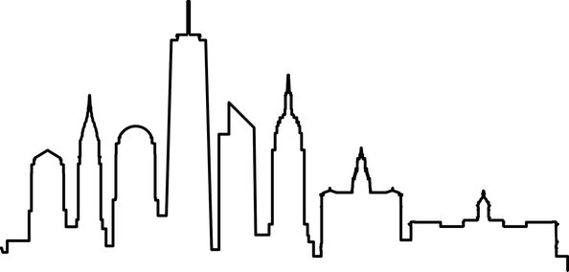

Sourmash
Sketching approach
Data compression that preserves salient features
Sketch
FracMinHash sketch
{TGACGCTG, TACTCGATG, CGTCACTG}
Reads
Reads
FracMinHash sketch
{TGACGCTG, AACTGGTC, TTTTGTCA}
Nota bene
Substrings of length k
We talk here about k-mers and metagenomics
AGCTCAGTCATGCGATCAGTACGTCATCATG
FracMinHash is a general purpose approach
AGCT
GCTC
CTCA
Appropriate for numerous applications
TCAG
CAGT
AGTC

Slide 5
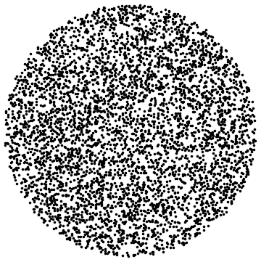
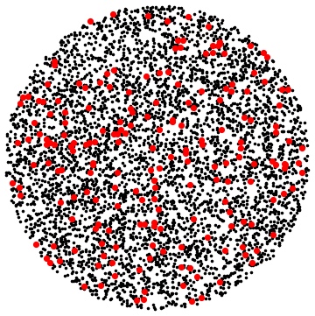

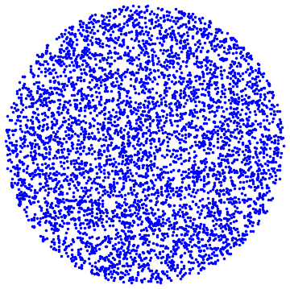
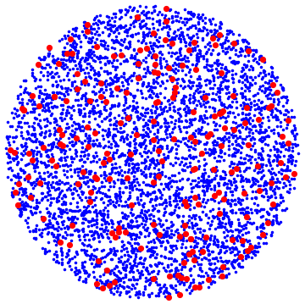
Sourmash
FracMinHash Intuition
Sketch
CGACATGCTTGAAAA
TCCGGAGGGGCAATT
AGGTGCGGATCACTG
GCCTACGGCTGCTTT
CTTATTTTCGGCCTA
CTGATTTTTTCGAGG
GGGTCCTTAAATGGC
ACTCTCTGCGATTGC
TGGCACCAATGTCAC
CTGTCTTTTGTTATG
CGACATGCTTGAAAA
TCCGGAGGGGCAATT
AGGTGCGGATCACTG
GCCTACGGCTGCTTT
CTTATTTTCGGCCTA
CTGATTTTTTCGAGG
GGGTCCTTAAATGGC
ACTCTCTGCGATTGC
TGGCACCAATGTCAC
CTGTCTTTTGTTATG
Reads
Get all
K-mers
Randomly
sample
List of
sampled
k-mers
Some fraction, of k-mers
Overlap = similarity
CGACATGCTTGAAAA
ATCCTATACGTTCAG
AGGTGCGGATCACTG
ACCTATCGTTCGCGG
GCCTACGGCTGCTTT
CTGATTTTTTCGAGG
ACGTCGATATGCACT
ACTCTCTGCGATTGC
TTTTTGACACGACAA
TGGCACCAATGTCAC
CGACATGCTTGAAAA
ATCCTATACGTTCAG
AGGTGCGGATCACTG
ACCTATCGTTCGCGG
GCCTACGGCTGCTTT
CTGATTTTTTCGAGG
ACGTCGATATGCACT
ACTCTCTGCGATTGC
TTTTTGACACGACAA
TGGCACCAATGTCAC
Randomly
sample
List of
sampled
k-mers
Reads
Get all
K-mers

Slide 6


Sourmash
FracMinHash Definition
Scale:
i.e. how much compression
Hash function:
does the random sampling
FracMinHash sketch¹:
Set of k-mers
Below some fraction
of the max
K-mers
Hash values
1. https://twitter.com/ctitusbrown/status/1465360407518928909
H
sketch
s=20%

Slide 7
FracMinHash
Generality
Can use FracMinHash sketches to measure many things
ANI estimation¹
Cosine similarity & other metric estimation²
Metagenomic taxonomic profiling
Metagenomic functional profiling³
dNdS estimation⁴
User-friendly tooling⁵: Sourmash
1. Hera, M. R., Pierce-Ward, N. T., & Koslicki, D. (2023). Deriving confidence intervals for mutation rates across a wide range of evolutionary distances using FracMinHash. Genome research, 33(7), 1061-1068.
2. Hera, M. R., & Koslicki, D. (2024). Cosine Similarity Estimation Using FracMinHash: Theoretical Analysis, Safety Conditions, and Implementation. WABI 2024, In Press.
3. Hera, M. R., Liu, S., Wei, W., Rodriguez, J. S., Ma, C., & Koslicki, D. (2023). Metagenomic functional profiling: to sketch or not to sketch? ECCB 2024, In Press.
4. Rodriguez, J.S., Hera, M. R., & Koslicki, D. (2024). Estimating nonsynonymous to synonymous mutation rates with FracMinHash. In progress
5. Irber, L., Pierce-Ward, N. T., Abuelanin, M., Alexander, H., Anant, A., Barve, K., ... & Brown, C. T. (2024). sourmash v4: A multitool to quickly search, compare, and analyze genomic and metagenomic data sets. Journal of Open Source Software, 9(98), 6830.

Slide 8
YACHT: Yes/No Answers to Community
membership via Hypothesis Testing
Motivation
YACHT
Experiments
Code & Conclusion

Slide 9



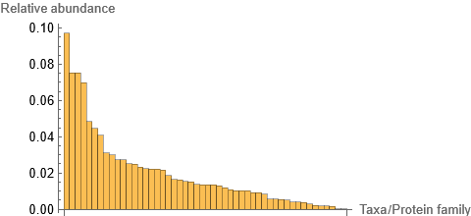
Motivation
(Meta)genomics
Raw (meta)genomic reads
Reference database/info
(Microbial) genome 1
Reads
(Microbial) genome 2
~1.2M genomes
. . .
Goal
{1,0,0,1,…}
Ignore all this
Presence/absence of reference
genomes in a sample
Problem
How to disentangle noise
and low abundance organisms?
Current approaches
Rare microbiome: in the sample at low abundance, or noise?
Hard thresholding, uninformed thresholds, FP’s remain, …

Slide 10
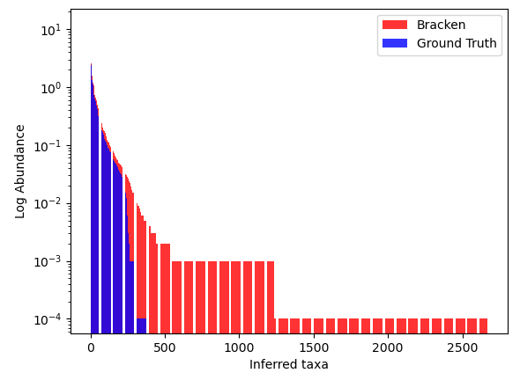
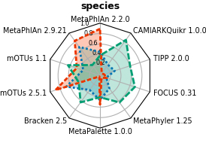
Motivation
(Meta)genomics
Raw (meta)genomic reads
Reference database/info
(Microbial) genome 1
Reads
(Microbial) genome 2
~1.2M genomes
. . .
Goal
{1,0,0,1,…}
Presence/absence of reference
genomes in a sample
- - - Precision
Problem
How to disentangle noise
and low abundance organisms?
Current approaches
Hard thresholding, uninformed thresholds, FP’s remain, …

Slide 11
YACHT: Yes/No Answers to Community
membership via Hypothesis Testing
Motivation
YACHT
Experiments
Code & Conclusion

Slide 12
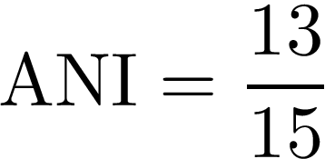
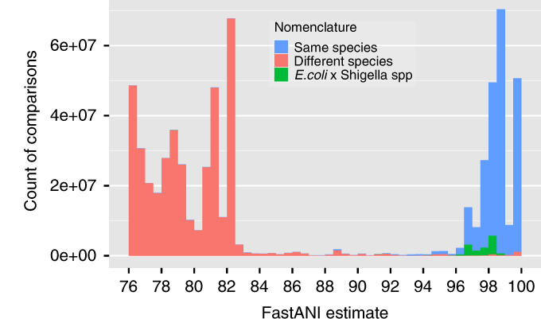
YACHT
ANI:
Average Nucleotide Identity
Ratio of matching vs. all characters in aligned pair of strings
E.g.
TCCGGAGGGGCAATT
TCTGGAGGGGCGATT
Observations
1. No organism in a metagenome will exactly match a reference genome
ANI to something
in the sample
Microbial genome 1
0.97
in/out?
Reads
Microbial genome 2
0.92
in/out?
. . .
2. Reference genomes won’t always have 1X coverage in metagenome
ANI
1X coverage
0.5X coverage
Desire
Statistical test to say a genome is in or out of a sample based on coverage and ANI to reference

Slide 13

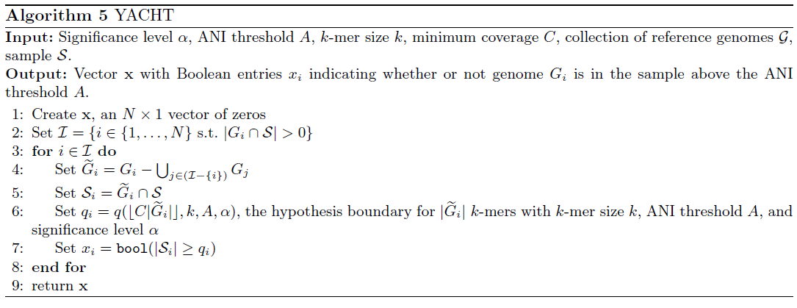
YACHT
YACHT test
Ignore all this
Given:
1. Confidence value (say, 95%)
2. Desired false negative rate
3. What % ANI means “same genome”
4. What coverage X means “in sample”
YACHT tells you:
Is there enough evidence (overlapping k-mers) to support the reference genome being “in” the sample.
Enough evidence?

Slide 14
YACHT
How does it work?
Raw (meta)genomic reads
Reference database
(Microbial) genome 1
Reads
(Microbial) genome 2
. . .

Slide 15
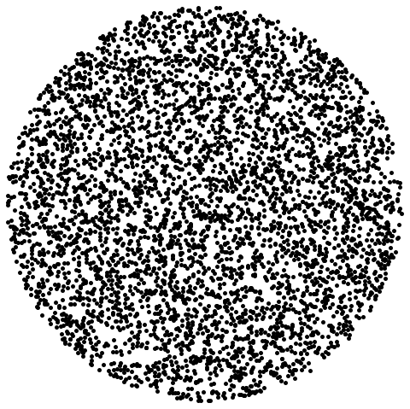
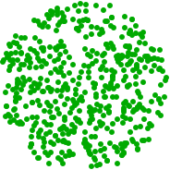
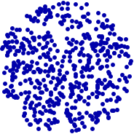
YACHT
How does it work?
Raw (meta)genomic k-mers
Reference database k-mers
(Microbial) genome 1
(Microbial) genome 2
Set of k-length strings
. . .
Convert to k-mers

Slide 16
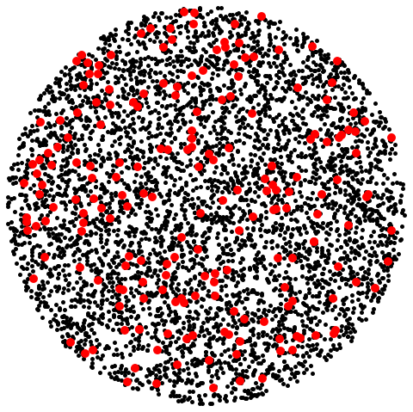
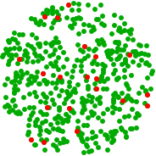
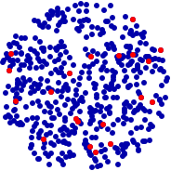
YACHT
How does it work?
Raw (meta)genomic k-mers
Reference database k-mers
(Microbial) genome 1
(Microbial) genome 2
Set of k-length strings
. . .
Convert to k-mers
Subsample/sketch

Slide 17
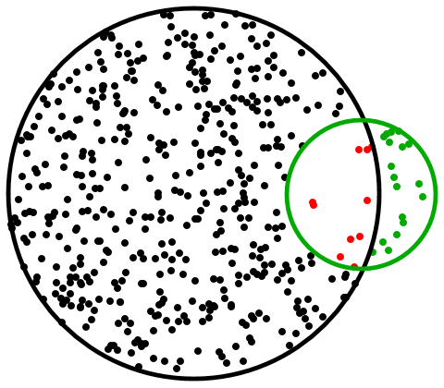
YACHT
How does it work?
Raw (meta)genomic k-mers
Reference database k-mers
(Microbial) genome 1
Set of k-length strings
Convert to k-mers
Subsample/sketch
Retain those with non-zero overlap with the sample

Slide 18
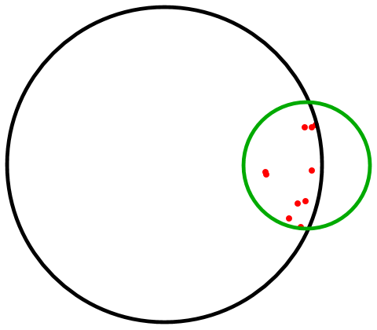
YACHT
How does it work?
Raw (meta)genomic k-mers
Reference database k-mers
(Microbial) genome 1
Set of k-length strings
Convert to k-mers
Subsample/sketch
Retain those with non-zero overlap with the sample
Get genome-specific k-mers

Slide 19
YACHT
How does it work?
Raw (meta)genomic k-mers
Reference database k-mers
(Microbial) genome 1
Set of k-length strings
Convert to k-mers
Subsample/sketch
Retain those with non-zero overlap with the sample
Get genome-specific k-mers
Calculate if there are enough to support the reference genome being “in” the sample

Slide 20
YACHT
How does it work?
Hypothesis test
Null hypothesis H₀: the genome is present in the sample
Genome
K-mers
Sample S

Slide 21
YACHT
How does it work?
Hypothesis test
Null hypothesis H₀: the genome is present in the sample
Mutated genome
Mutated k-mers
Sample S

Slide 22

YACHT
How does it work?
Hypothesis test
Null hypothesis H₀: the genome is present in the sample
Mutated genome
Mutated k-mers,
sketched:
Sample S,
sketched
K-mers shared with sample S

Slide 23
YACHT
How does it work?
Hypothesis test
Null hypothesis H₀: the genome is present in the sample
Mutated genome
Mutated k-mers,
sketched:
Sample S,
sketched
K-mers shared with sample S
Prob. k-mer unmutated
(ANI = non-mut. prob = a)

Slide 24





YACHT
How does it work?
Hypothesis test
Null hypothesis H₀: the genome is present in the sample
Mutated genome
Mutated k-mers,
sketched:
So for
and
largest such that
Sample S,
sketched
significance (1-FN rate)
Fewest k-mers we would see (w.p. α) if the mutated genome was present
Then:
Genome in sample (accept H₀)
Genome not in sample (reject H₀)

Slide 25
Experiments
Knobs you can twiddle
K-mer size
ANI threshold: what ANI constitutes “same genome”
Significance: how sure you want negatives to be true negatives
Min coverage: The percentage of a genome's k-mers required to confirm its presence
Most important parameters

Slide 26
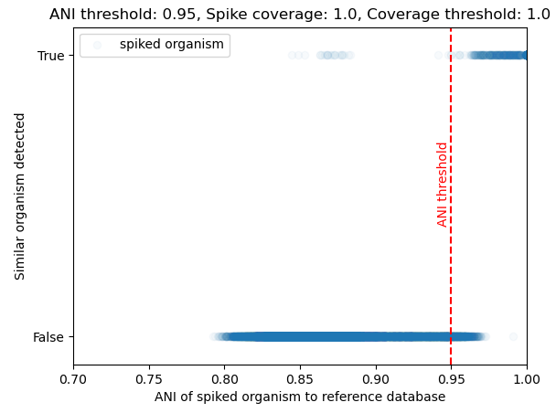
Experiments
On spike-in real data
Real metagenome, artificially mutated real genome reads inserted
High powered
Reads at known
coverage and ANI
2.94% FP
Spike in
Metagenome
0.2% FN
Repeat 29k times

Slide 27
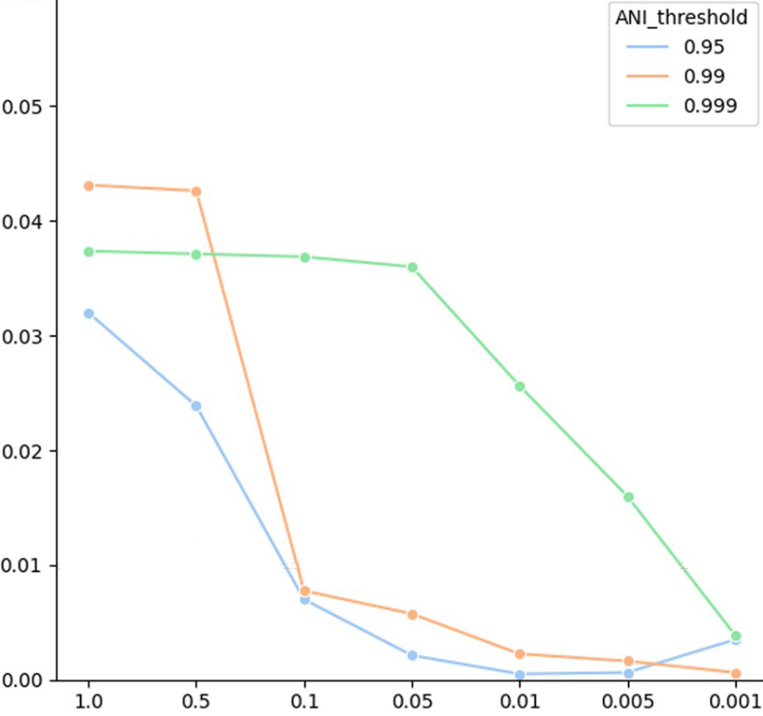
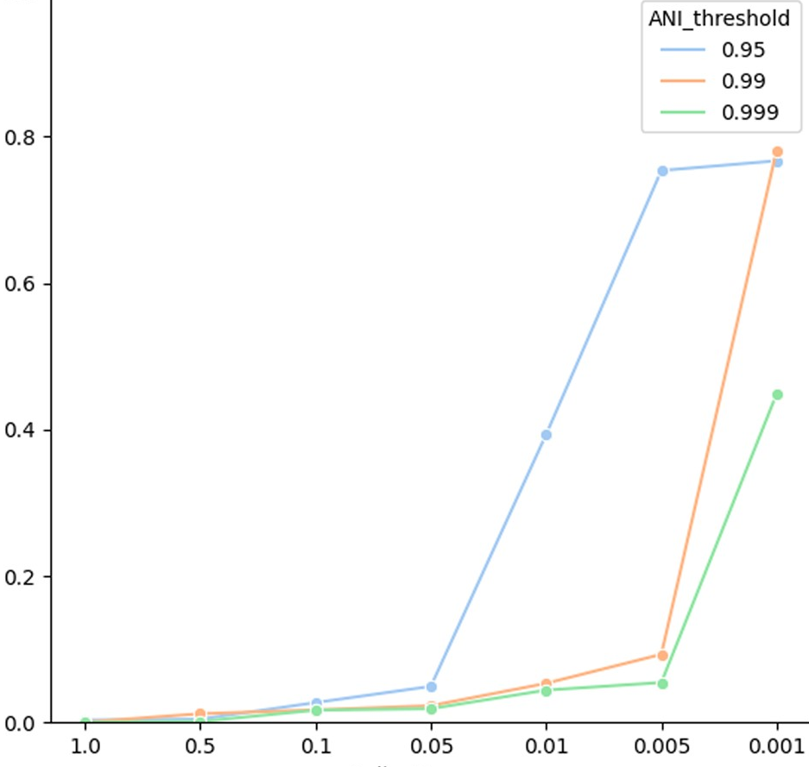
Experiments
On spike-in real data
Real metagenome, artificially mutated real genome reads inserted
High powered
Behaves as expected
False Negative Rate
False Positive Rate
Minimum coverage
Minimum coverage

Slide 28
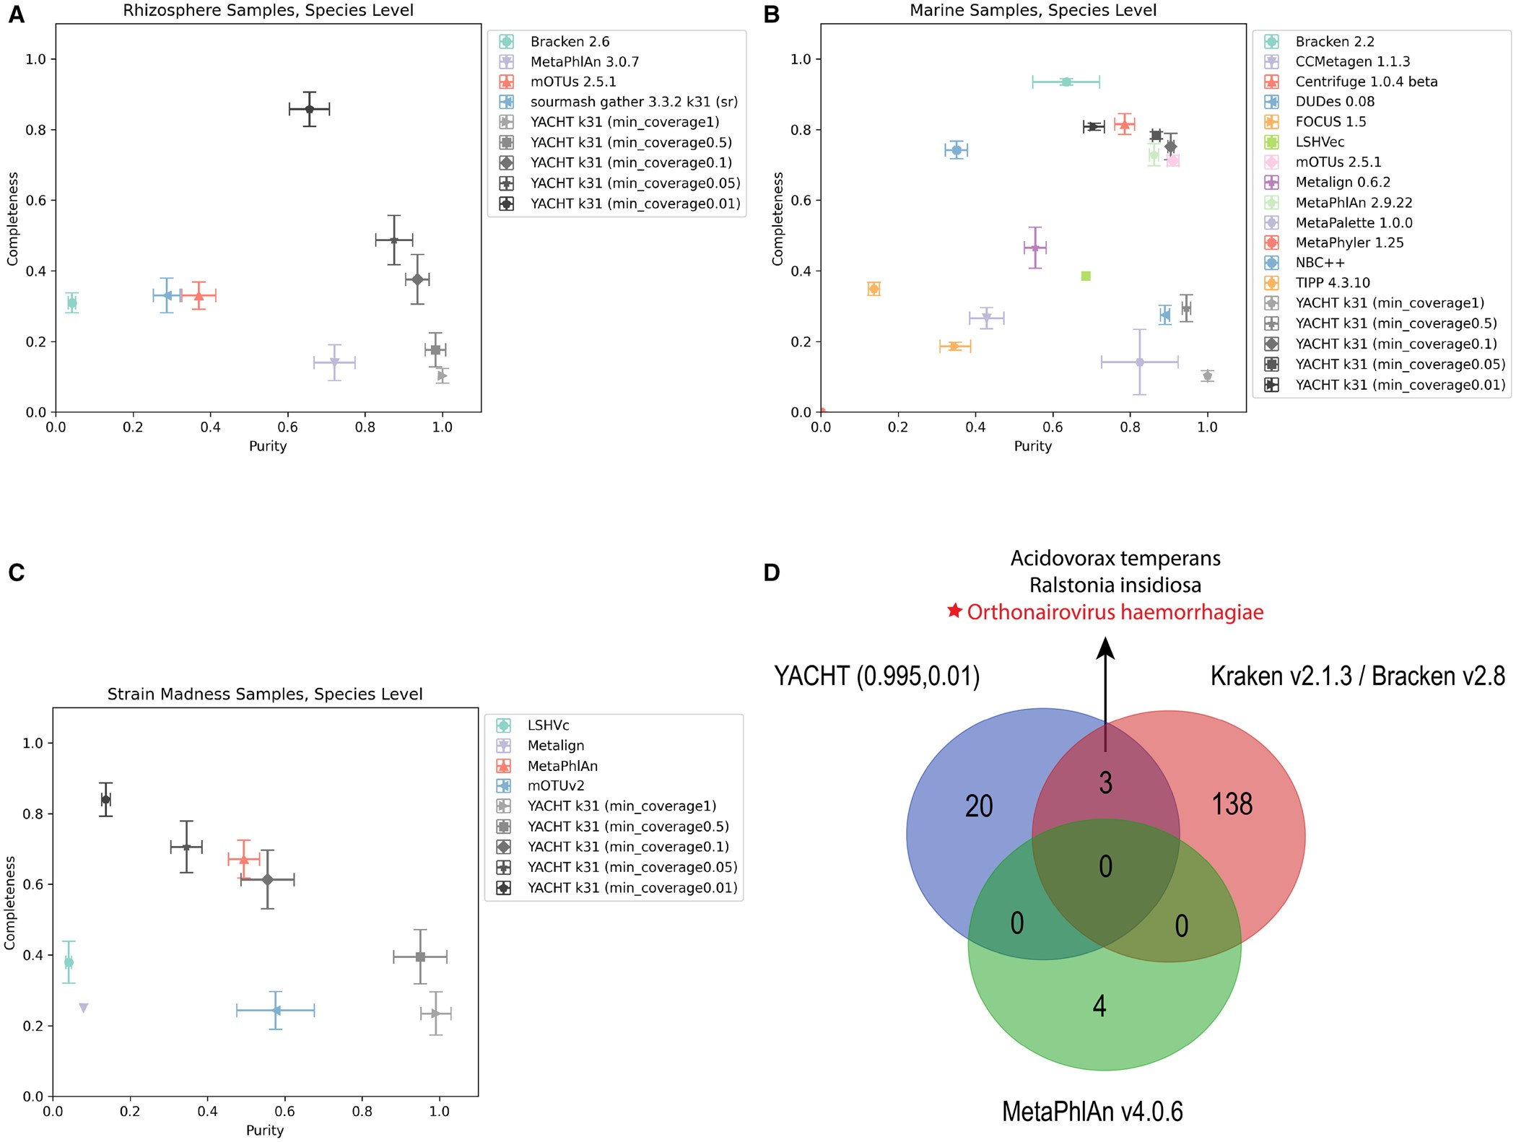
Experiments
On CAMI data
Critical assessment of metagenomic interpretation, benchmark data
Completeness/
recall
Purity/precision
Meyer, F., Fritz, A., Deng, Z. L., Koslicki, D., Lesker, T. R., Gurevich, A., ... & McHardy, A. C. (2022). Critical assessment of metagenome interpretation: the second round of challenges. Nature methods, 19(4), 429-440.

Slide 29
Experiments
On CAMI data
Critical assessment of metagenomic interpretation, benchmark data
Completeness/
recall
Purity/precision
Meyer, F., Fritz, A., Deng, Z. L., Koslicki, D., Lesker, T. R., Gurevich, A., ... & McHardy, A. C. (2022). Critical assessment of metagenome interpretation: the second round of challenges. Nature methods, 19(4), 429-440.

Slide 30
Experiments
On CAMI data
Critical assessment of metagenomic interpretation, benchmark data
Completeness/
recall
Purity/precision
Meyer, F., Fritz, A., Deng, Z. L., Koslicki, D., Lesker, T. R., Gurevich, A., ... & McHardy, A. C. (2022). Critical assessment of metagenome interpretation: the second round of challenges. Nature methods, 19(4), 429-440.

